Slide 1
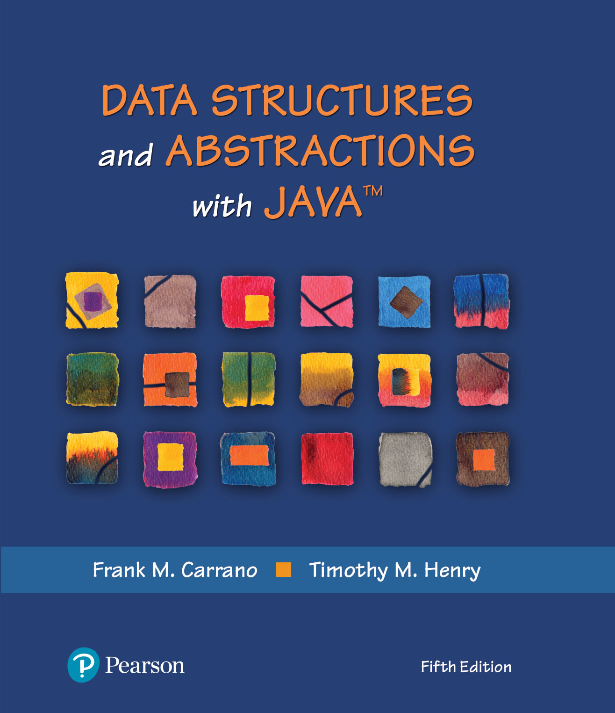
Module 19 - Heaps
Ch. 27 - A Heap Implementation

Slide 2
Video Notes
Adding to a Heap
https://mediaplayer.pearsoncmg.com/assets/secs-vn-ch27a-implementing-the-adt-heap
The Heap Sort
https://mediaplayer.pearsoncmg.com/assets/secs-vn-ch27b-the-heap-sort

Slide 3
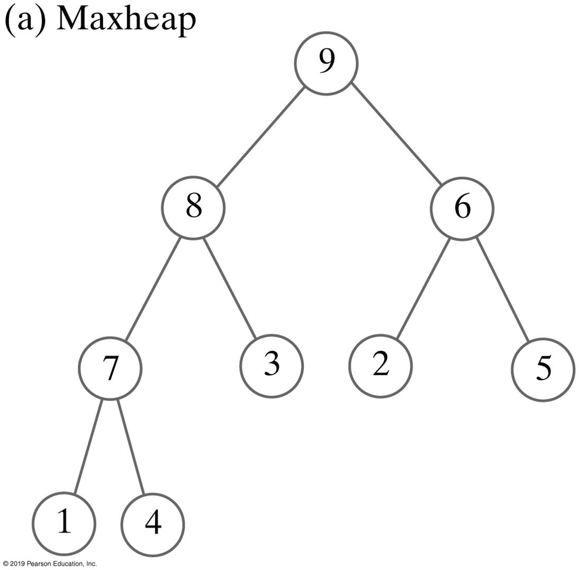

Heaps
Notes:
Max vs. Min Heaps

Slide 4
What’s a Heap?
Complete binary tree whose nodes contain Comparable objects and are organized as follows:
Each node contains an object no smaller/larger than objects in its descendants
Maxheap: object in node greater than or equal to its descendant objects
Minheap: object in node less than or equal to its descendant objects

Slide 5
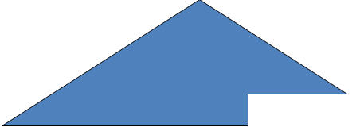
Properties of Heaps
All Heaps have a Shape and an Order (nodes contain comparable objects)
left balanced binary tree (complete binary tree)
All sub trees in a heap are themselves heaps
5

Slide 6
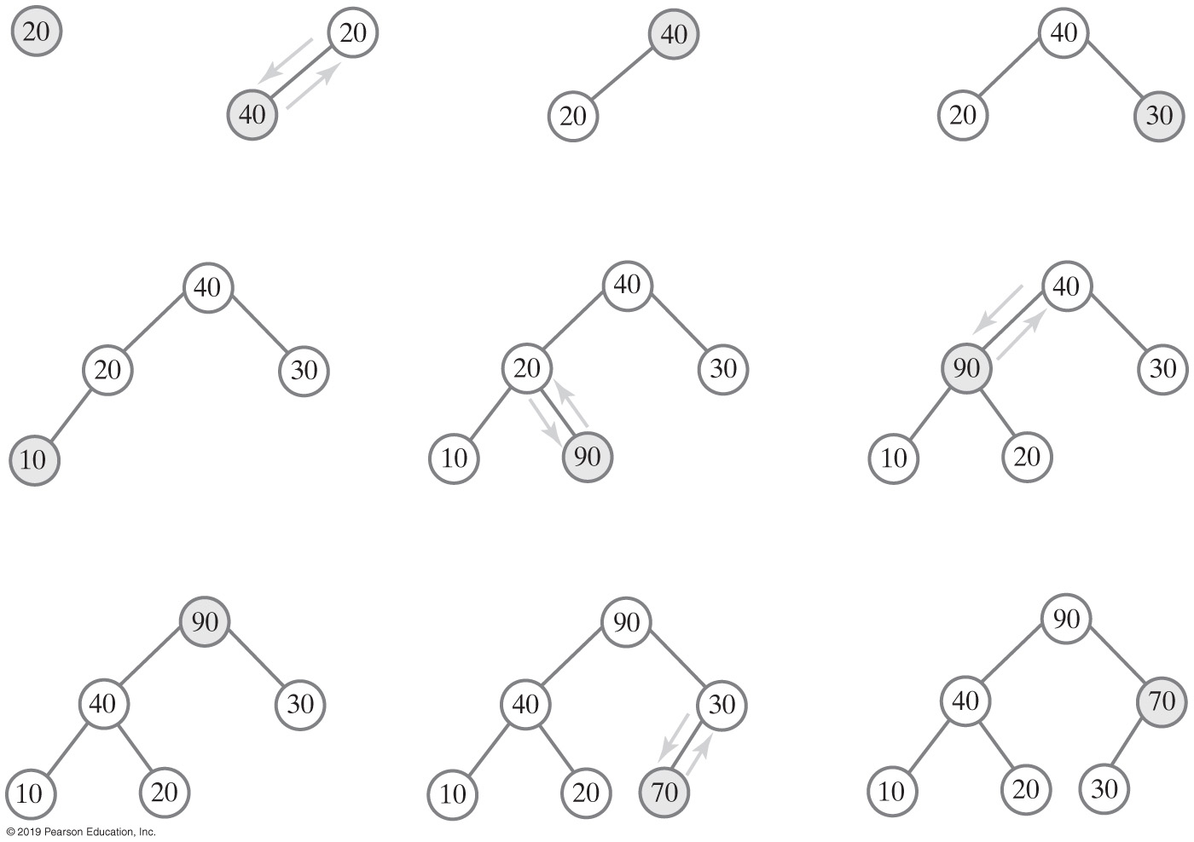
Creating a Maxheap (1 of 2)
Why 30 here ?
The steps in adding 20, 40, 30, 10, 90, and 70 to an initially empty heap

Slide 7
Creating a Maxheap (2 of 2)
The steps in adding 20, 40, 30, 10, 90, and 70 to an initially empty heap

Slide 8
Activity: Creating a Minheap
Data = [20, 40, 30, 10, 90, 70]
Create –
Binary tree
Binary search tree
Create a Minheap of the entries 20, 40, 30, 10, 90, and 70 (by using reheap)

Slide 9
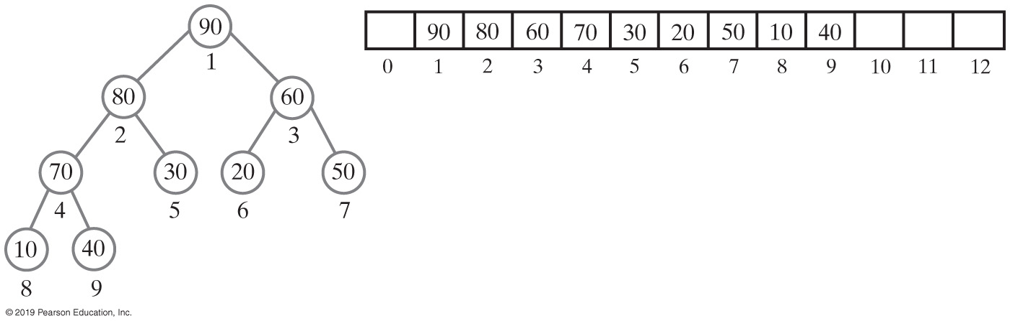
Heap | Array Representation
Use an array to represent a complete binary tree
Number nodes in the order in which a level-order traversal would visit them
Can locate either the children or the parent of any node
Perform a simple computation on the node’s number

Slide 10
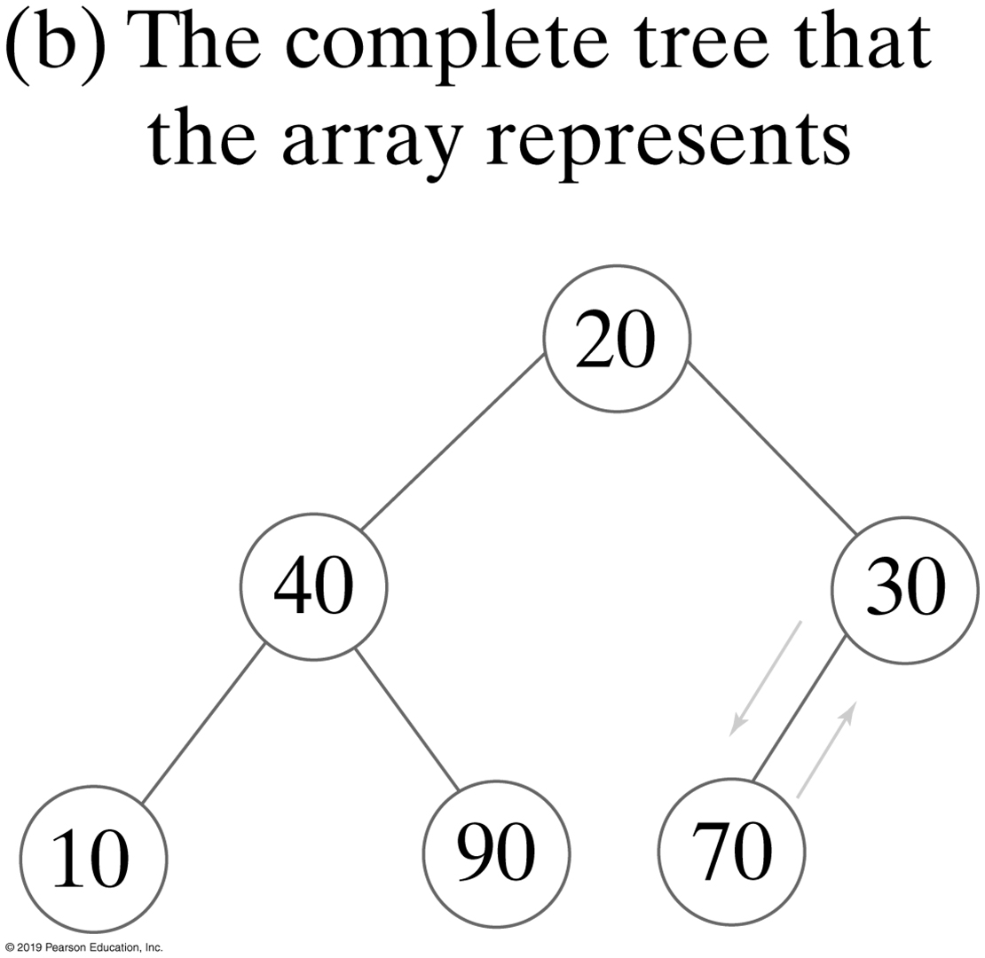
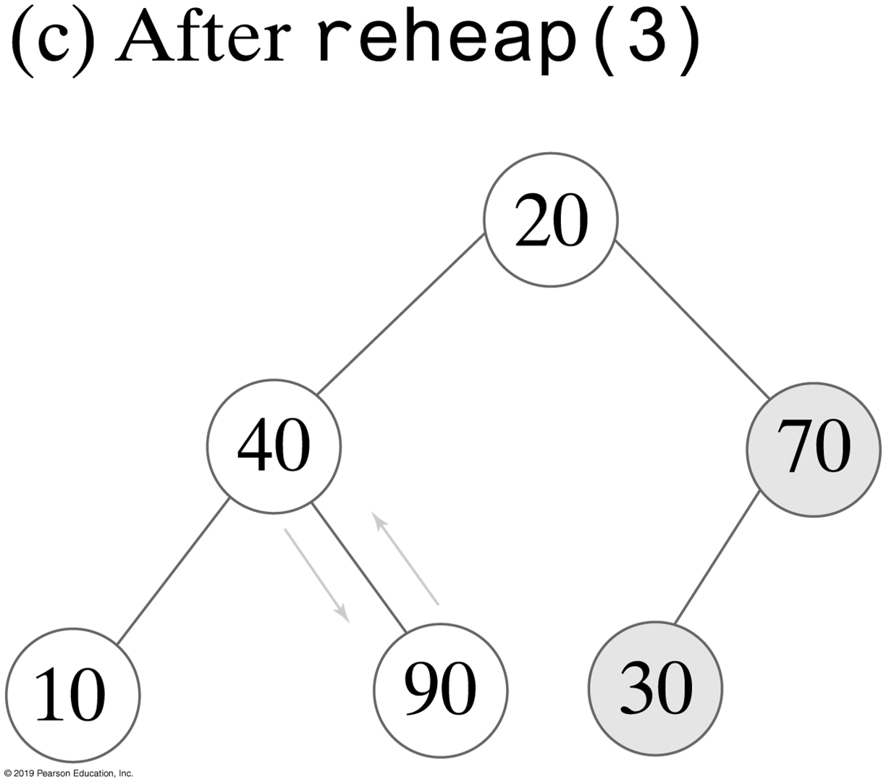
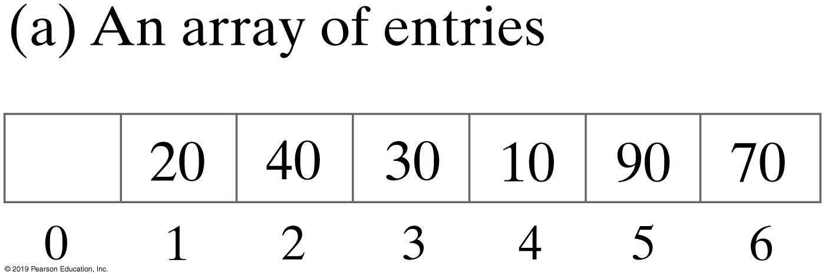
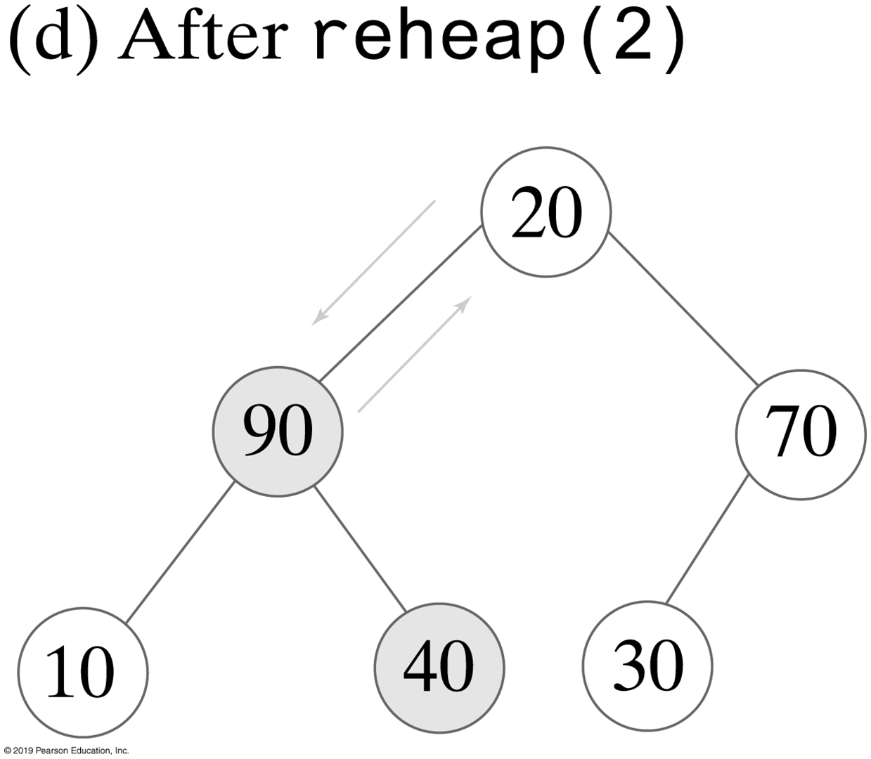
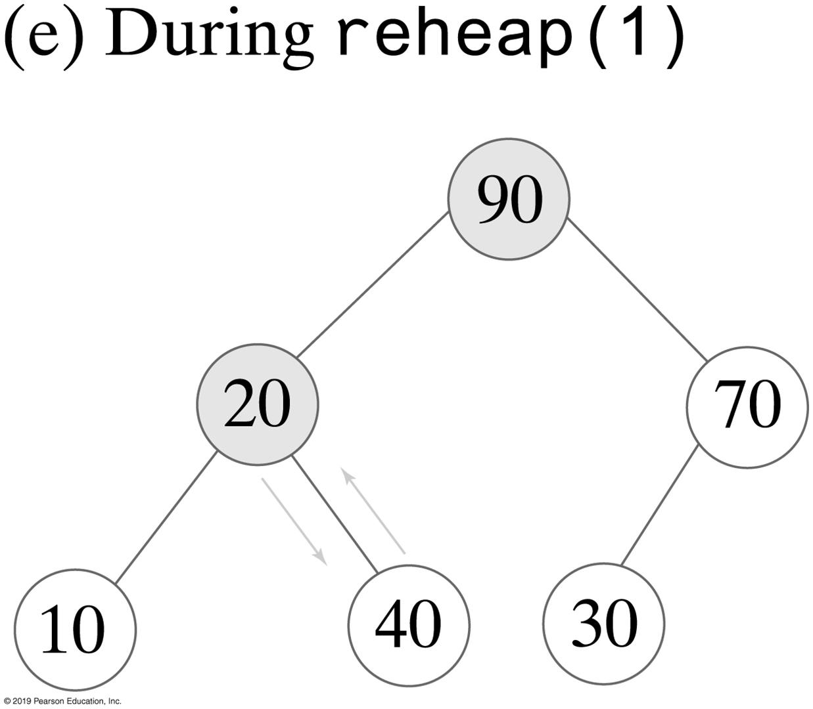
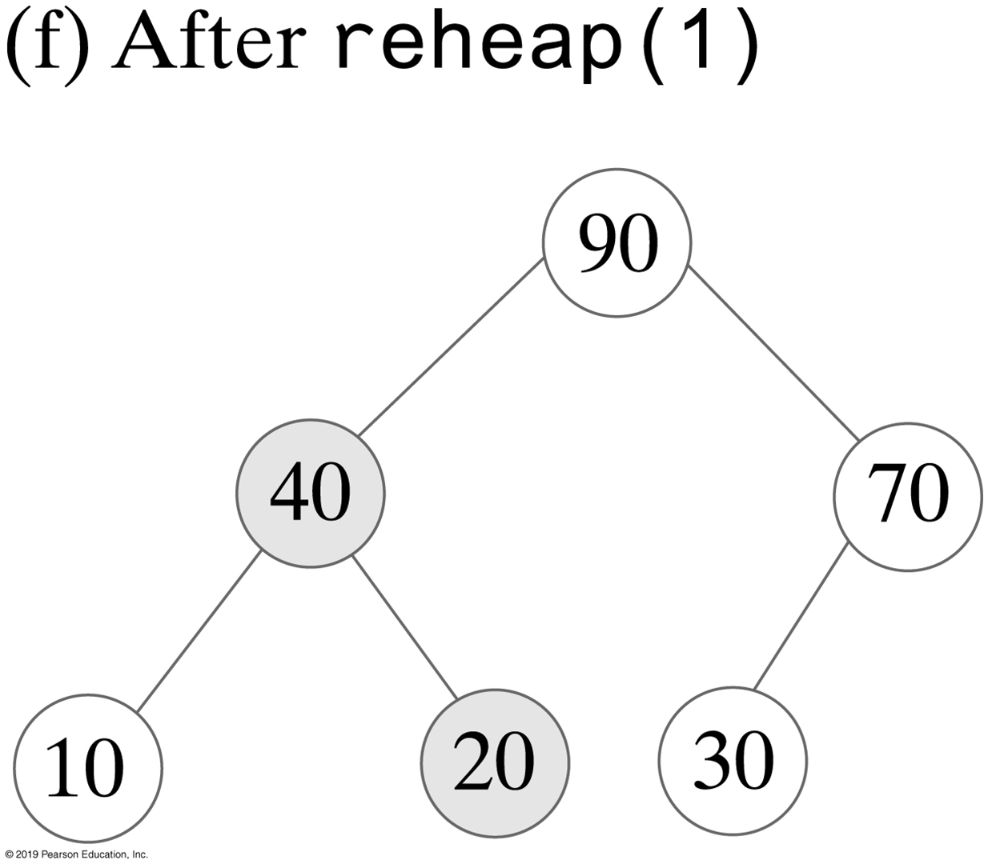
Creating a Heap from Existing Data

Slide 11
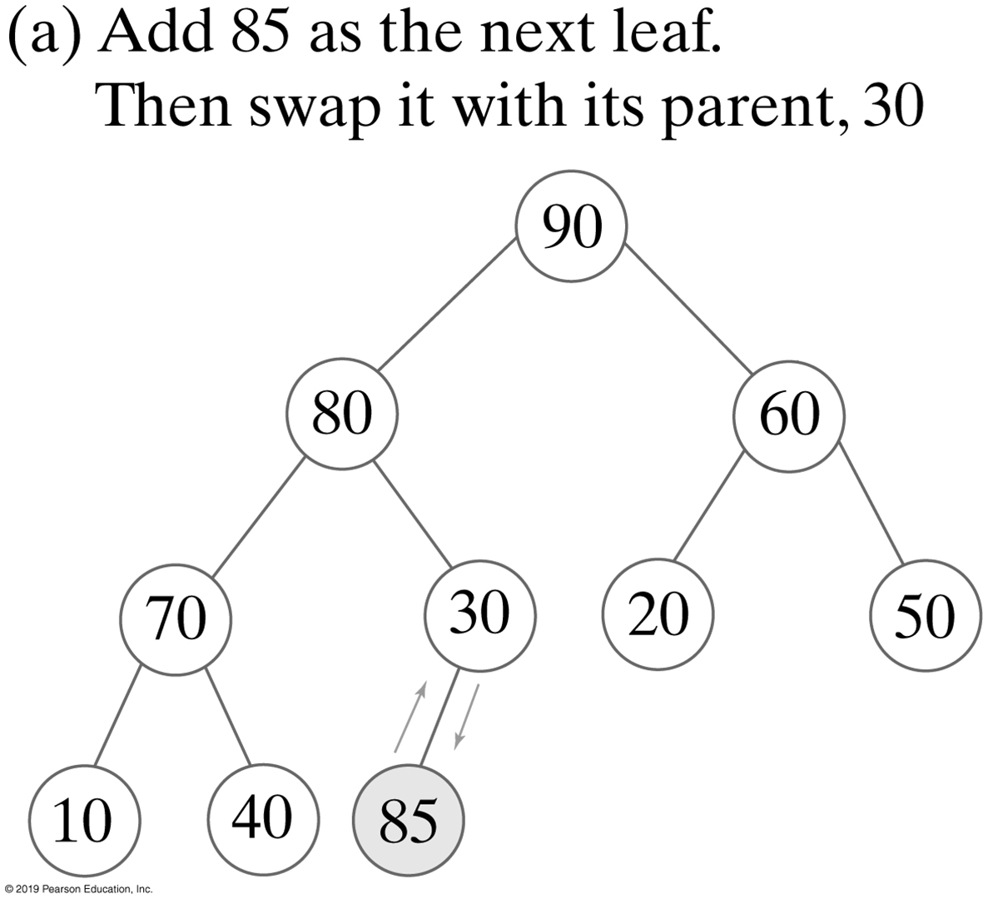
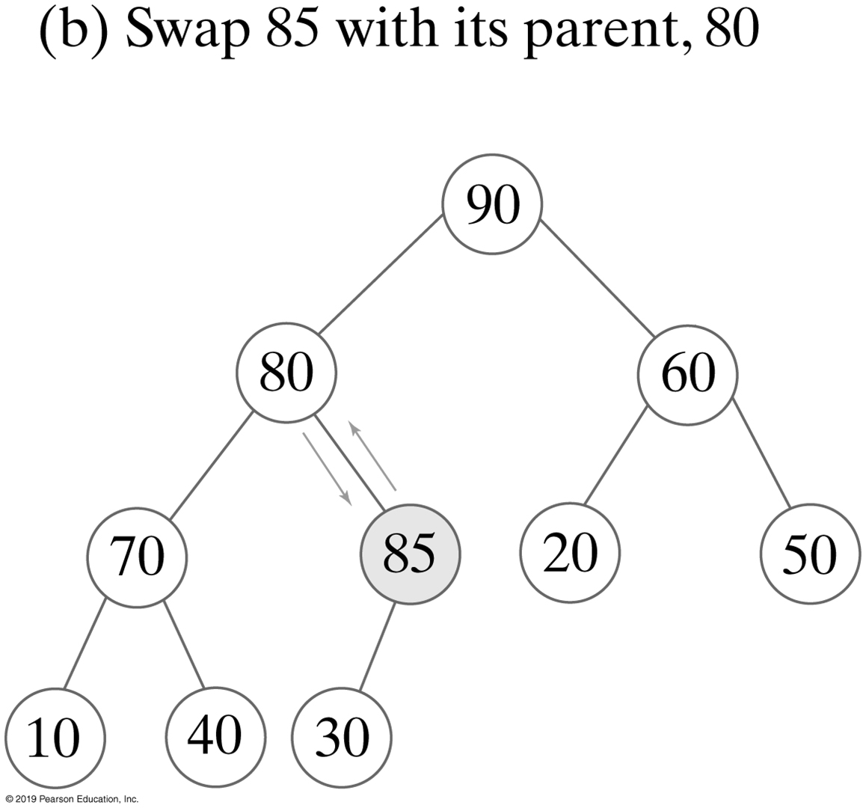
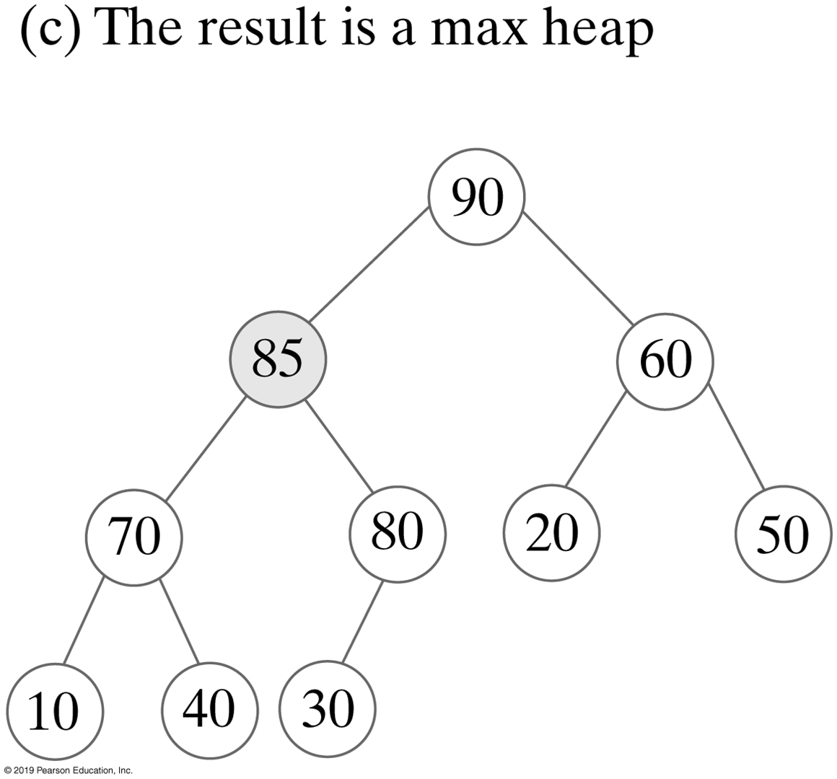
Adding a New Entry
The steps in adding 85 to the maxheap

Slide 12
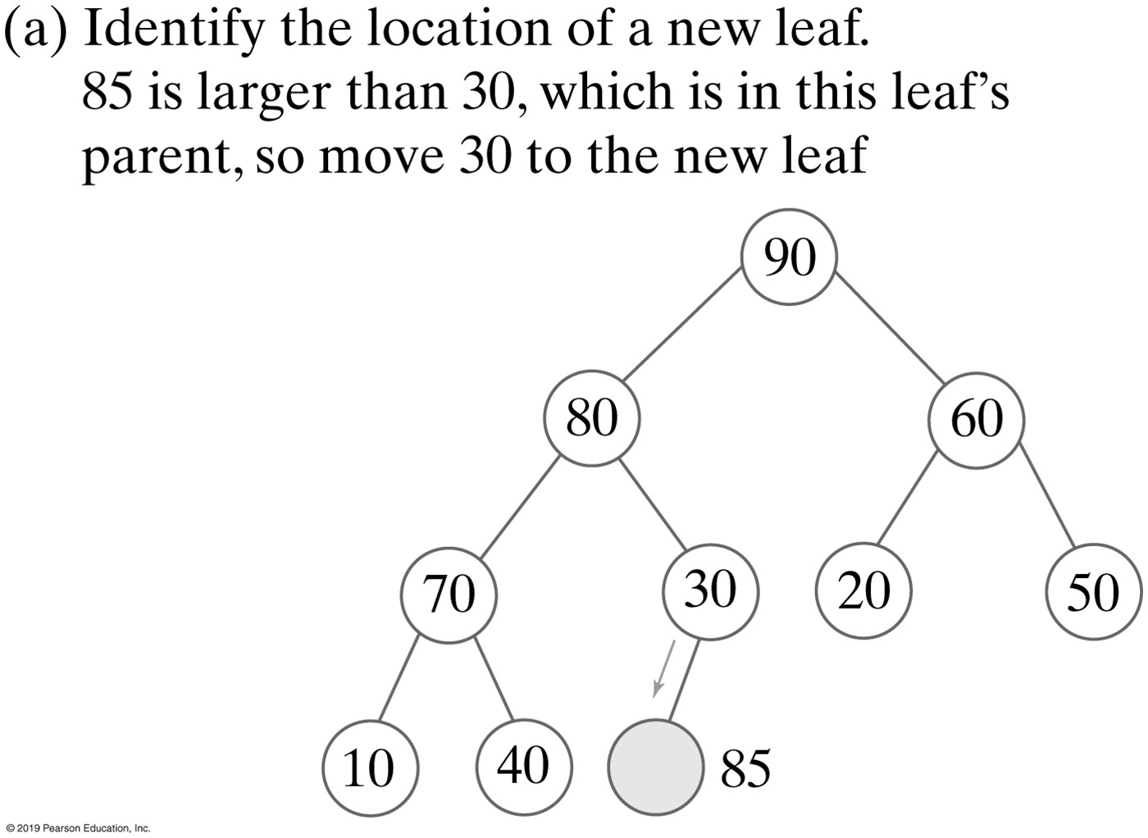
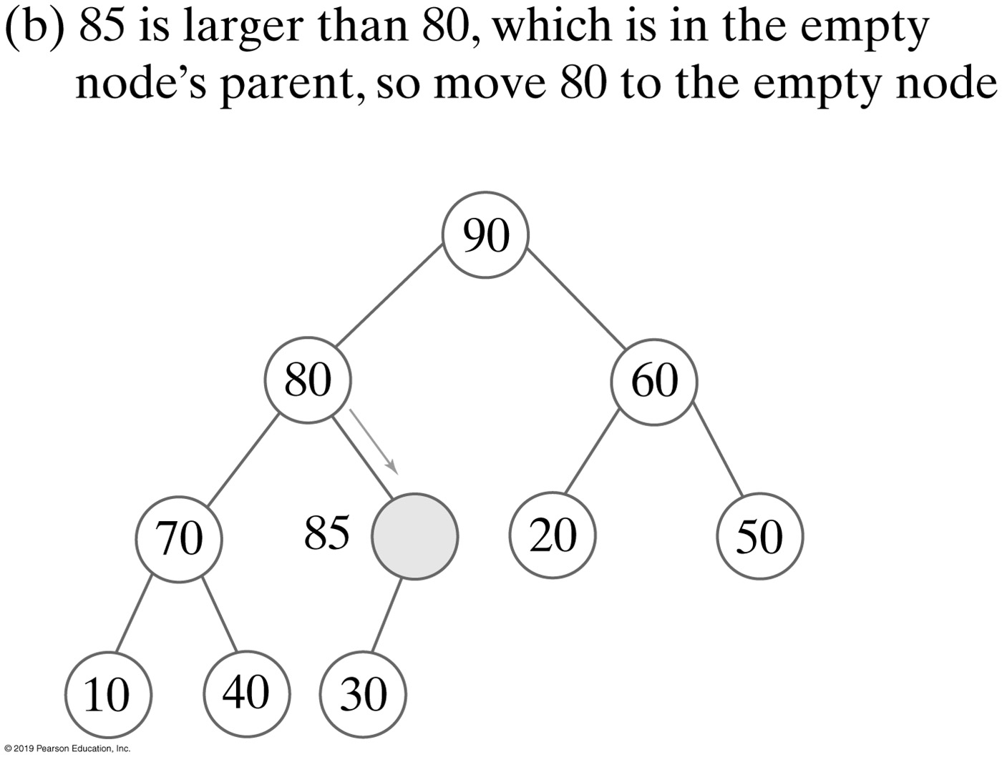
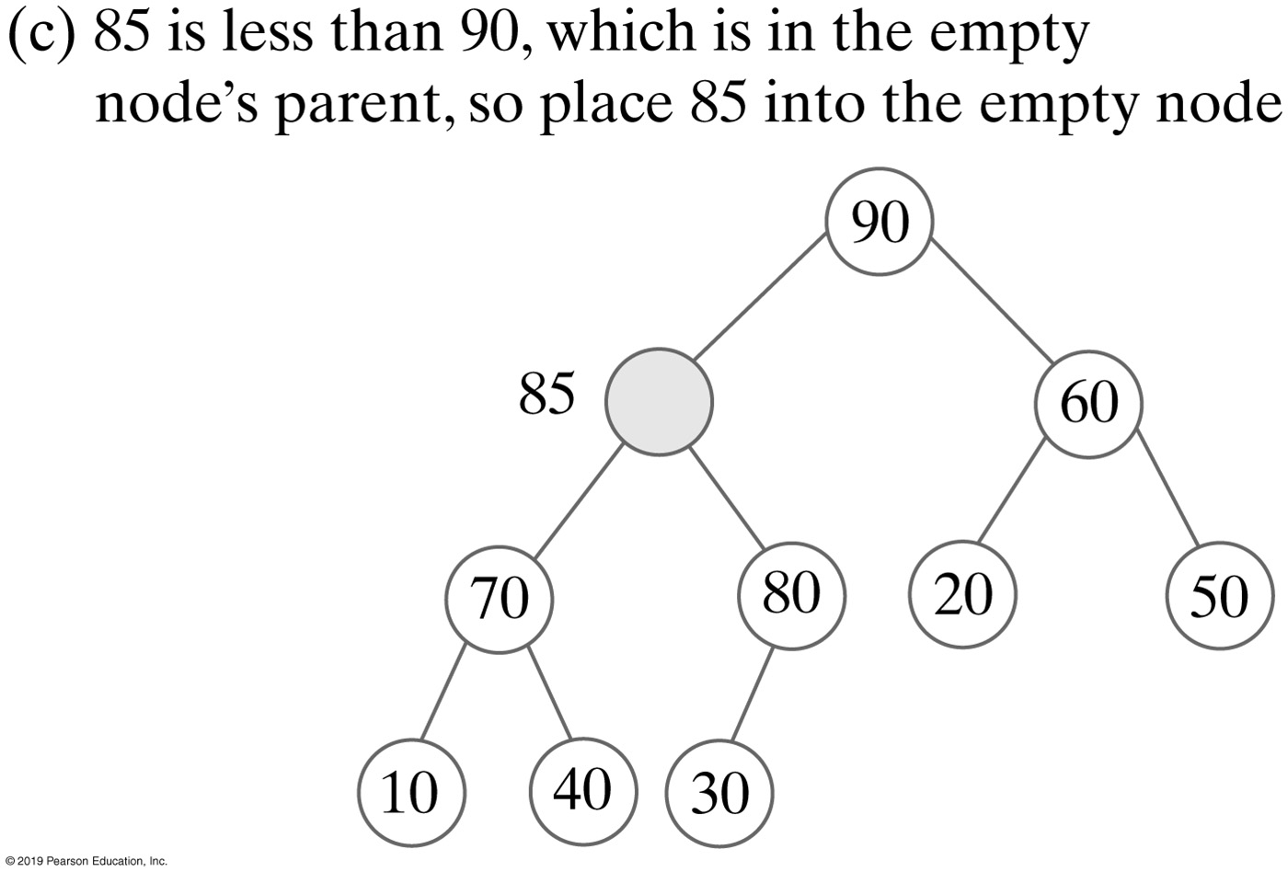
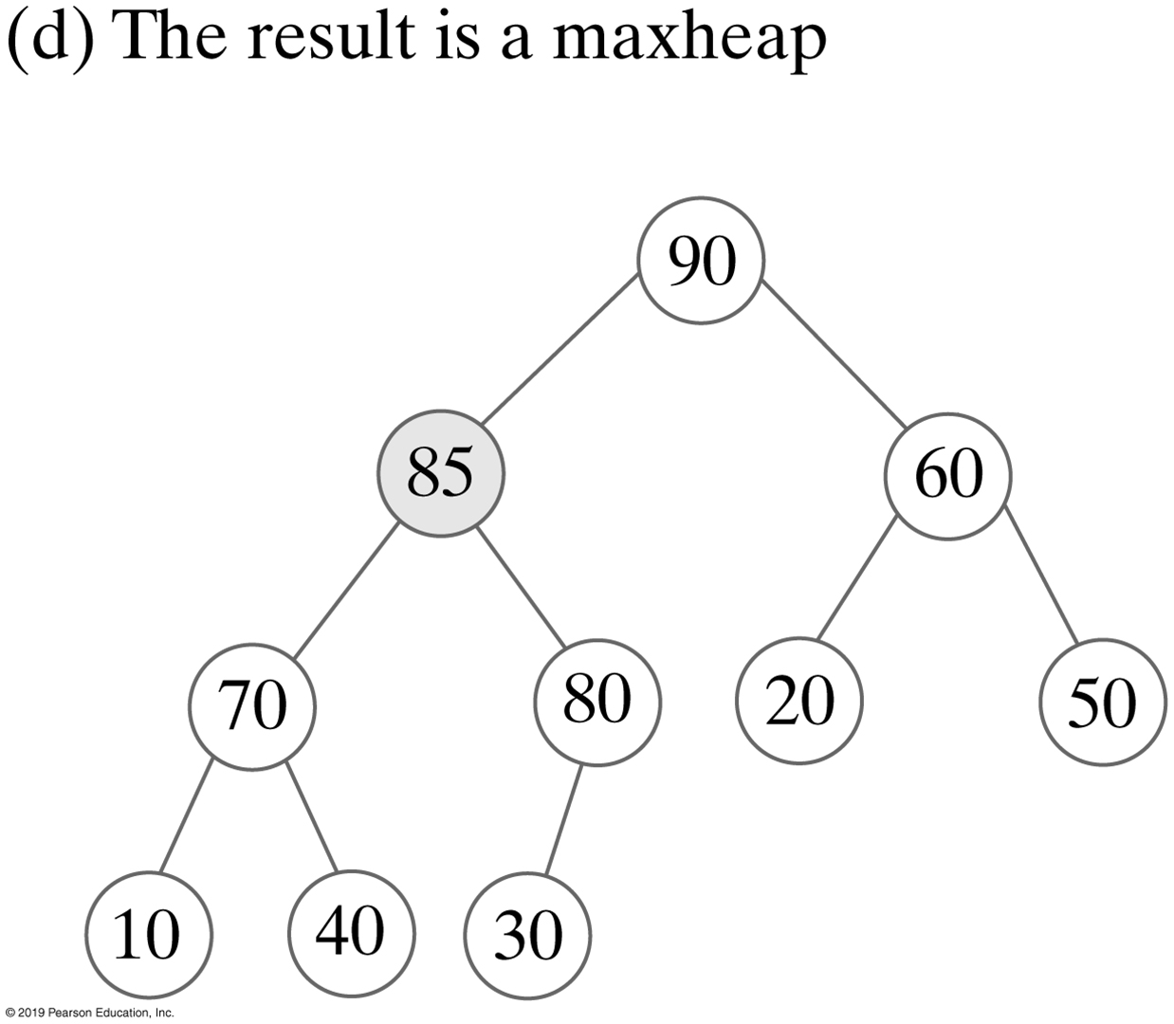
Adding an Entry without Swaps
A revision of the steps to add 85 to avoid swaps
Notes:
Add a new entry to an existing heap

Slide 13
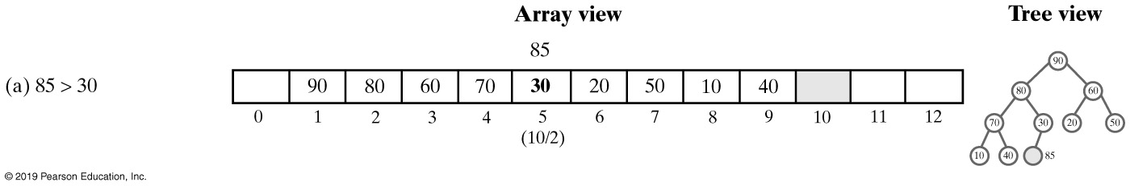
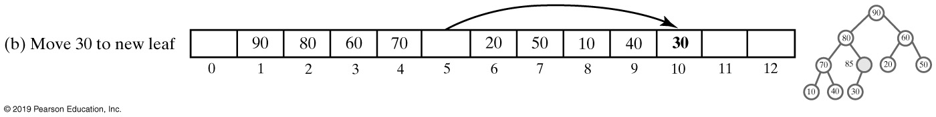
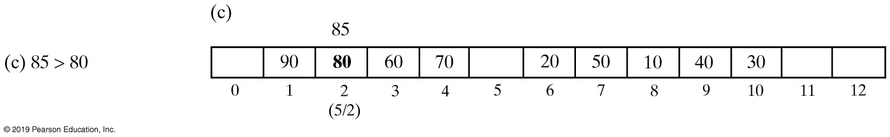
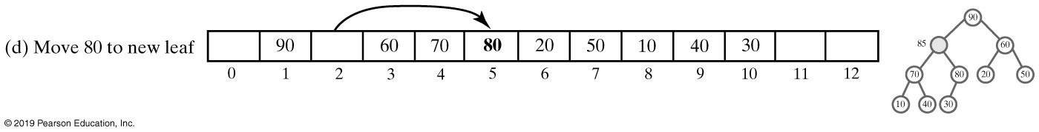
Adding an Entry to Heap (1 of 2)

Slide 14
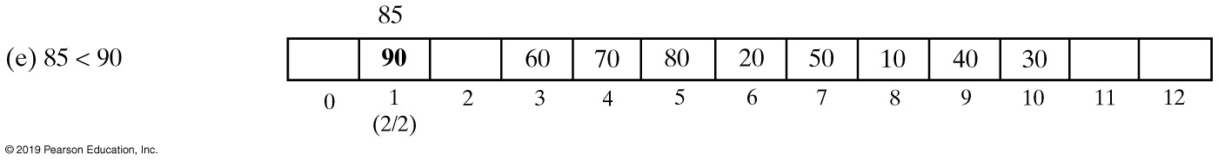
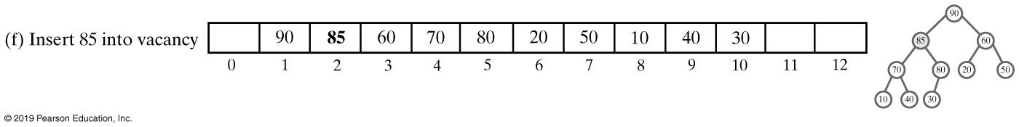
Adding an Entry to Heap (2 of 2)
An array representation of the steps

Slide 15
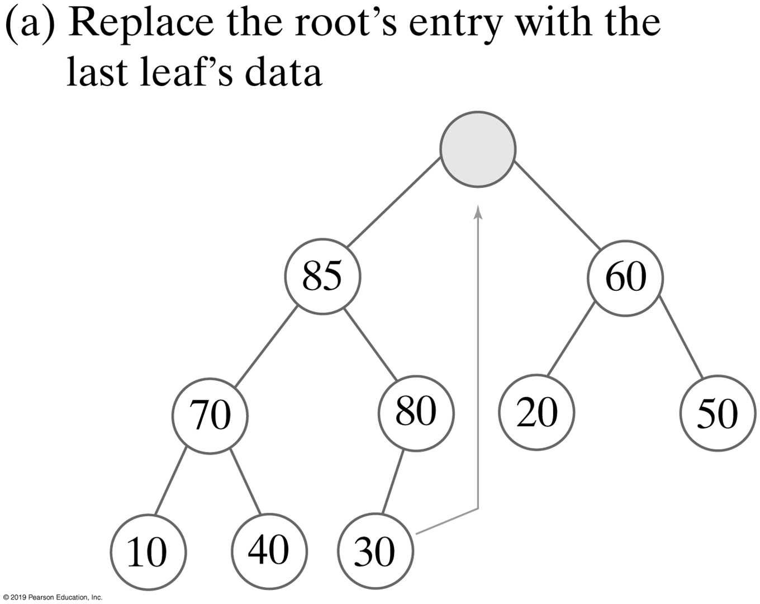
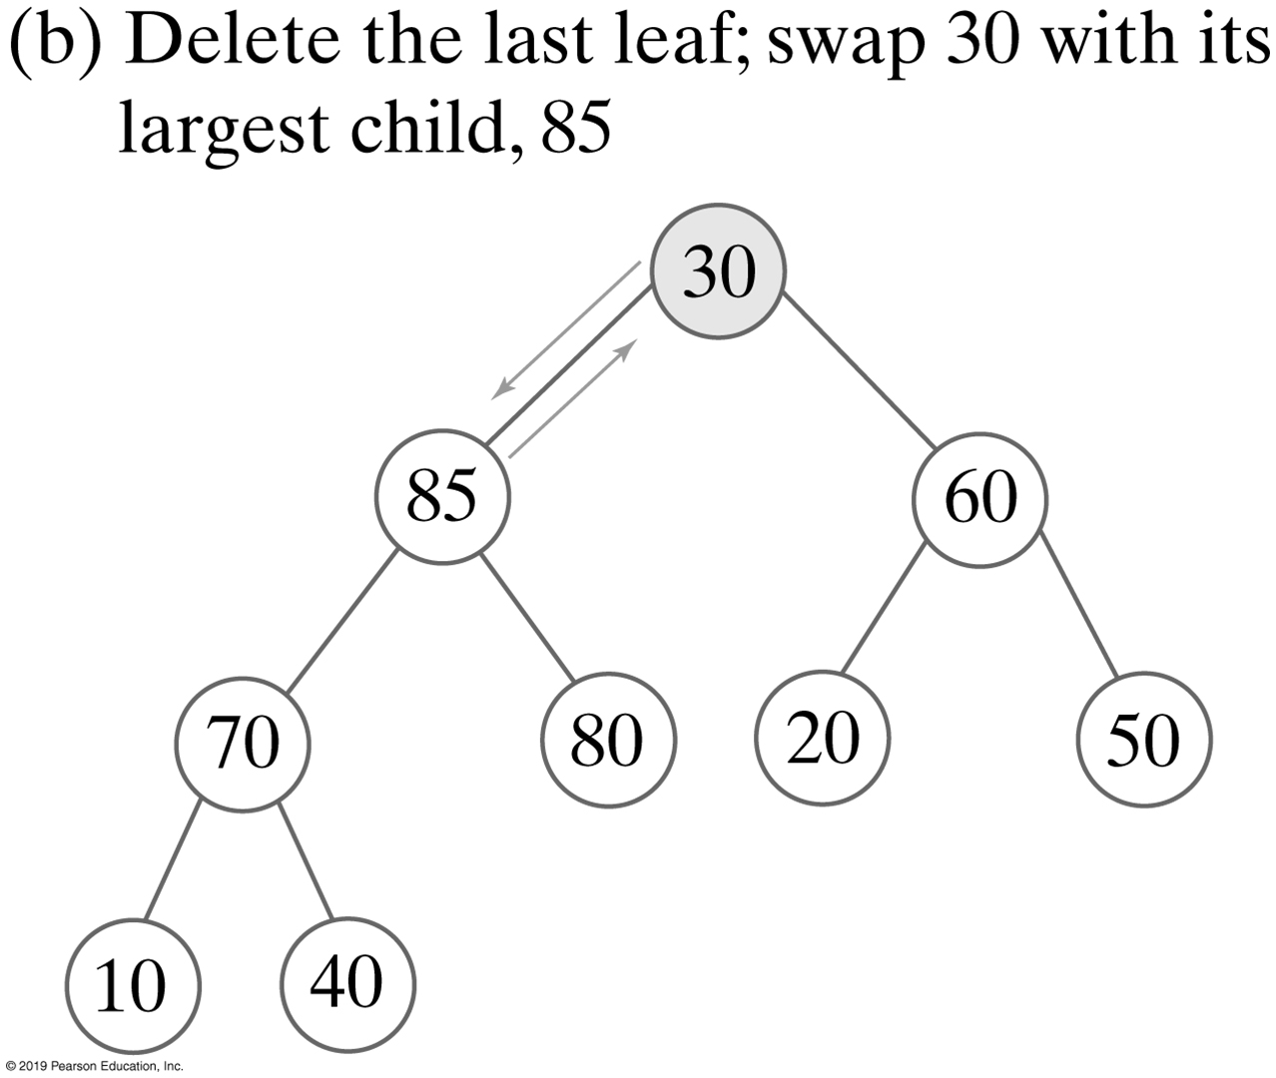
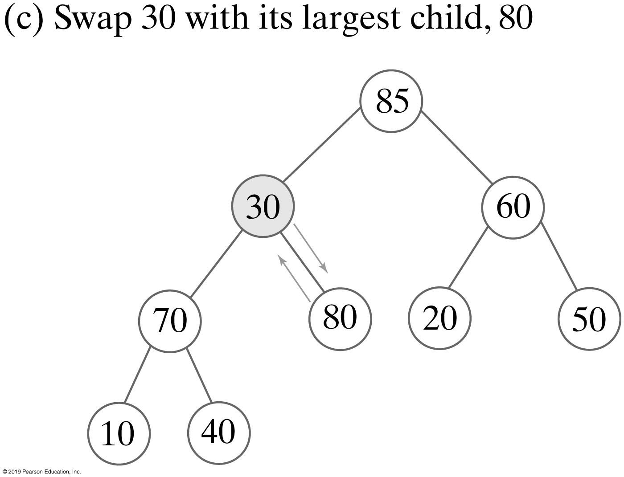
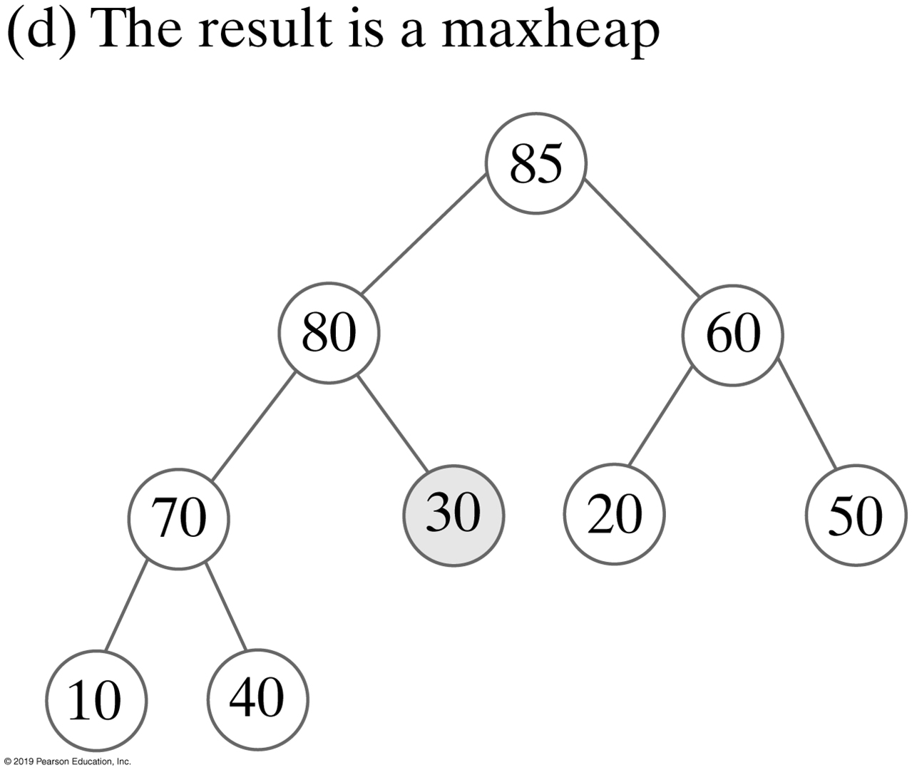
Removing a Value from A Heap
Why 80 here ?

Slide 16
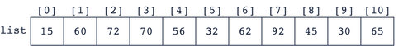
Build MaxHeap | Example
Is it a Heap?
How do you know?
Notes:
Build a binary tree first

Slide 17
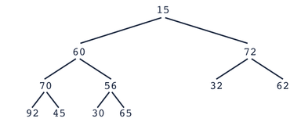
Build Heap – Another Example

Slide 18
Build Heap – Another Example
1. Find parent of last child = (child-1)/2 (integer division)
2. Find largest of children
3. If child > parent - SWAP!

Slide 19
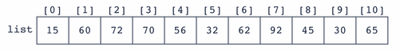
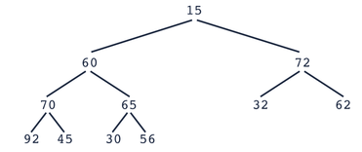
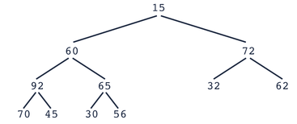
Build Heap
parent = (child-1)/2 (integer division)
Go to next parent
Find largest child

Slide 20
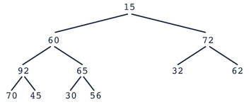
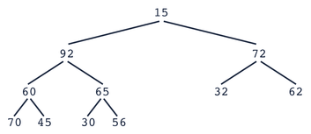
Build Heap
Is this a heap?

Slide 21
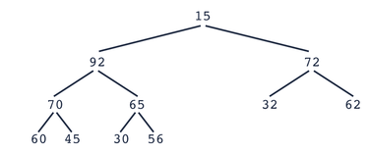
Build Heap
Check the last parent

Slide 22
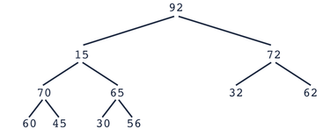
Build Heap
Is this a heap?
No, continue to “reheap” the tree with the “root” of 15

Slide 23

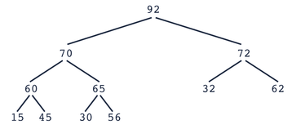
Build Heap

Slide 24
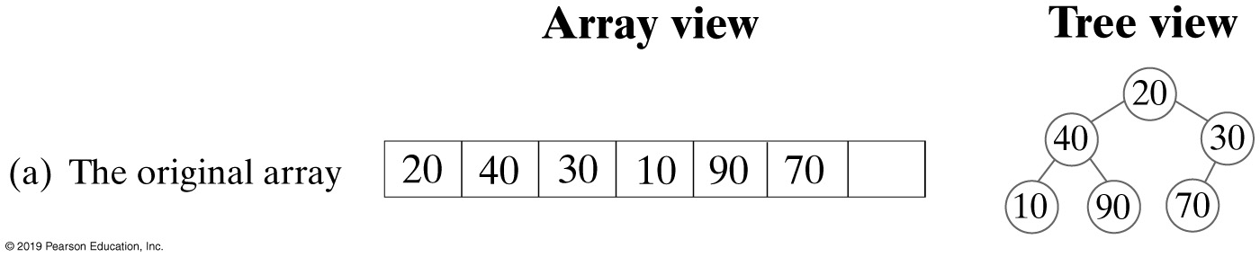
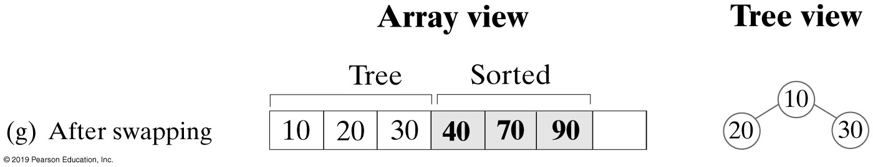
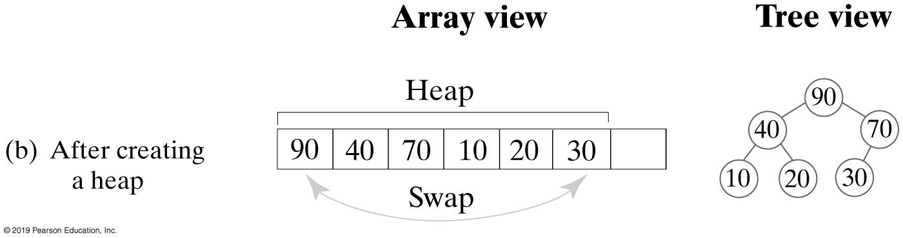
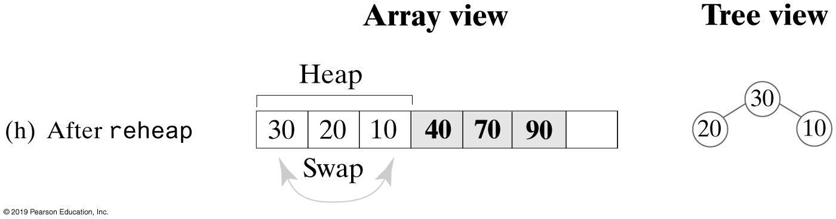
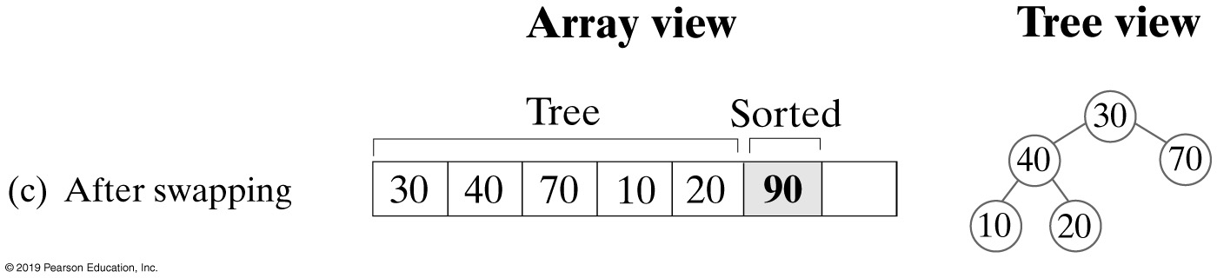
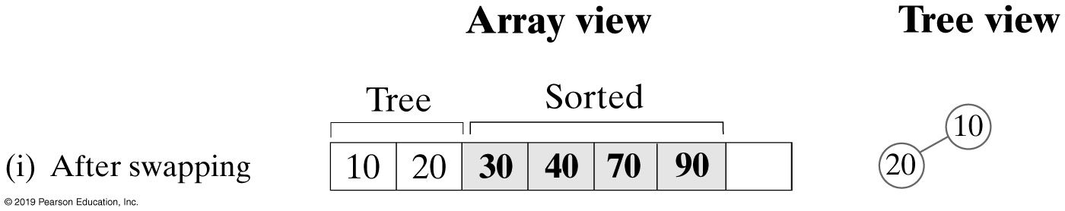
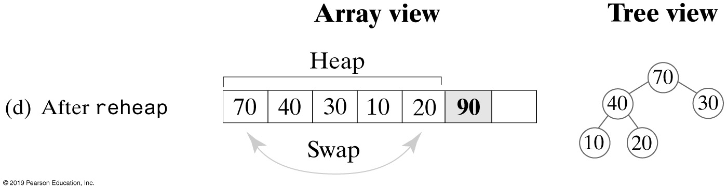
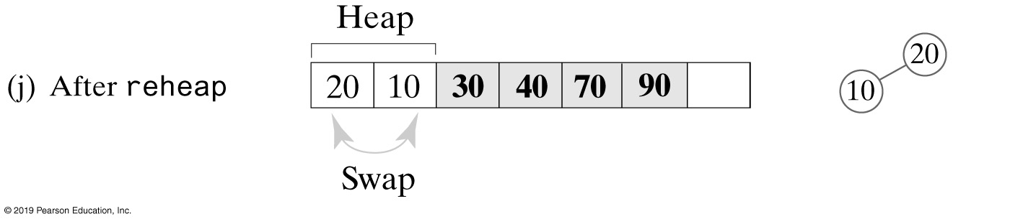
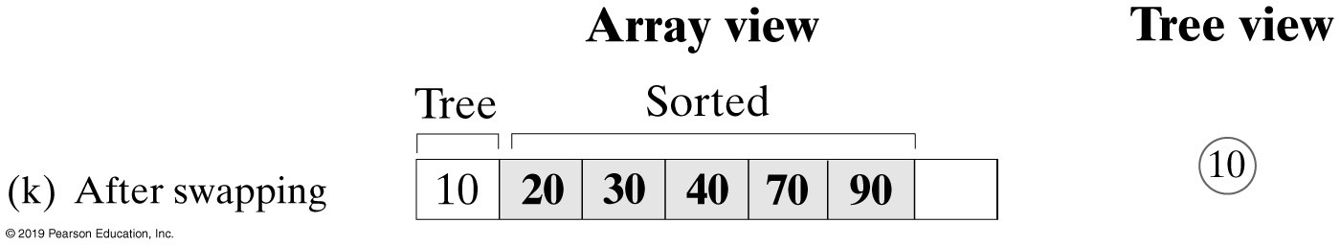
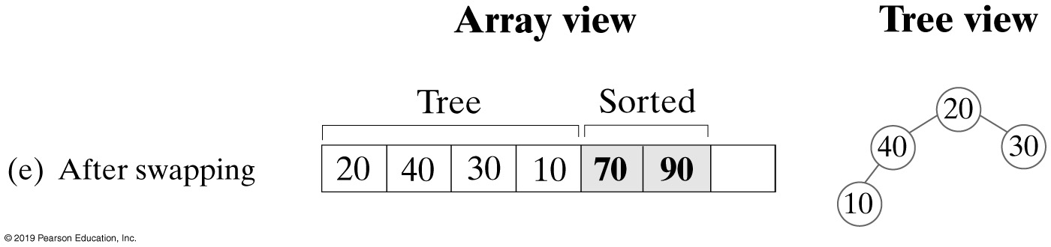
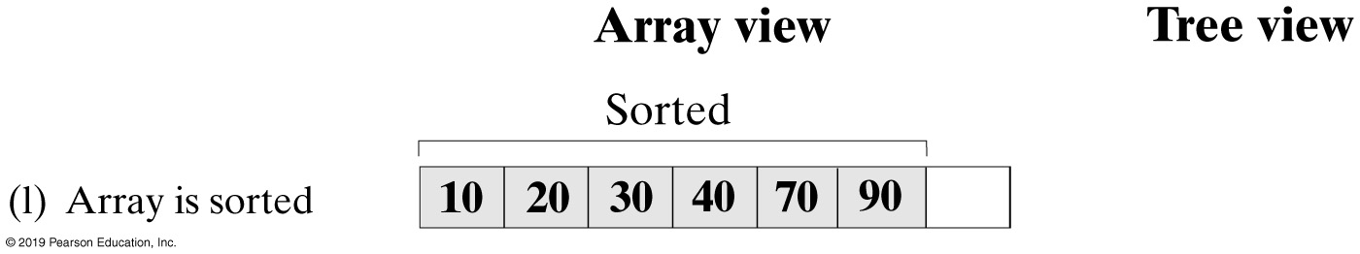
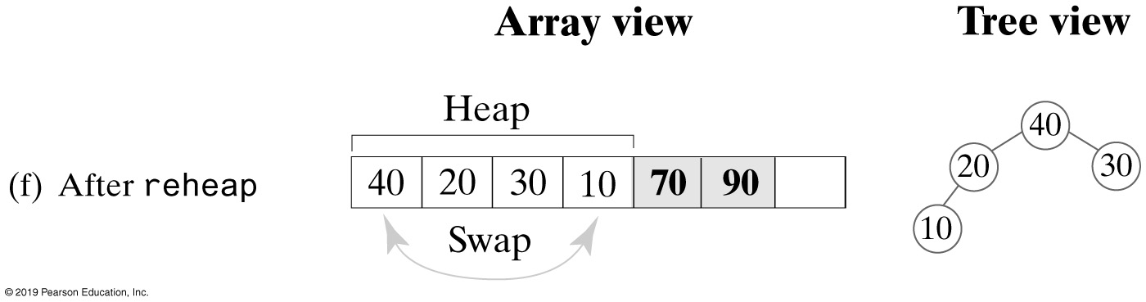
Heap Sort
A trace of heap sort

Slide 25
Activity: Heap Sort Example
tree.nodes
[ 0 ]
[ 1 ]
[ 2 ]
[ 3 ]
[ 4 ]
[ 5 ]
[ 6 ]
70
60
12
40
30
8
Notes:
Build heap
Remove root
Reheap

Slide 26
Heap Sort Example
tree.nodes
[ 0 ]
[ 1 ]
[ 2 ]
[ 3 ]
[ 4 ]
[ 5 ]
[ 6 ]
tree
70
60
12
40
30
8
70
0
60
1
12
2
40
3
30
4
8
5
Swap the root with the last item in the heap
Reheap down(0,4)
Notes:
Build heap
Remove root
Reheap

Slide 27
Heap Sort
tree.nodes
[ 0 ]
[ 1 ]
[ 2 ]
[ 3 ]
[ 4 ]
[ 5 ]
[ 6 ]
tree
8
60
12
40
30
70
8
0
60
1
12
2
40
3
30
4
Swap the root with the last item in the heap
Reheap down (0,4)

Slide 28
Heap Sort
tree.nodes
[ 0 ]
[ 1 ]
[ 2 ]
[ 3 ]
[ 4 ]
[ 5 ]
[ 6 ]
tree
60
40
12
8
30
70
60
0
40
1
12
2
8
3
30
4
Swap the root with the last item in the heap
Reheap down(0,3)

Slide 29
Heap Sort
tree.nodes
[ 0 ]
[ 1 ]
[ 2 ]
[ 3 ]
[ 4 ]
[ 5 ]
[ 6 ]
tree
30
40
12
8
60
70
30
0
40
1
12
2
8
3
Swap the root with the last item in the heap
Reheap down(0,3)

Slide 30
Heap Sort
tree.nodes
[ 0 ]
[ 1 ]
[ 2 ]
[ 3 ]
[ 4 ]
[ 5 ]
[ 6 ]
tree
40
30
12
8
60
70
40
0
30
1
12
2
8
3
Swap the root with the last item in the heap
Reheap down(0,2)

Slide 31
Heap Sort
tree.nodes
[ 0 ]
[ 1 ]
[ 2 ]
[ 3 ]
[ 4 ]
[ 5 ]
[ 6 ]
tree
8
30
12
40
60
70
8
0
30
1
12
2
Swap the root with the last item in the heap
Reheap down(0,2)

Slide 32
Heap Sort
tree.nodes
[ 0 ]
[ 1 ]
[ 2 ]
[ 3 ]
[ 4 ]
[ 5 ]
[ 6 ]
tree
30
8
12
40
60
70
30
0
8
1
12
2
Swap the root with the last item in the heap
Reheap down(0,2)

Slide 33
Heap Sort
tree.nodes
[ 0 ]
[ 1 ]
[ 2 ]
[ 3 ]
[ 4 ]
[ 5 ]
[ 6 ]
tree
12
8
30
40
60
70
12
0
8
1
Swap the root with the last item in the heap
Reheap down(0,1) – already a heap

Slide 34
Heap Sort
tree.nodes
[ 0 ]
[ 1 ]
[ 2 ]
[ 3 ]
[ 4 ]
[ 5 ]
[ 6 ]
tree
8
12
30
40
60
70
8
0
Swap the root with the last item in the heap
Reheap down(0,0) – done

Slide 35
Implementations

Slide 36
Heap and Maxheap
/** An interface for the ADT maxheap. */
public interface MaxHeapInterface<T extends Comparable<? super T>>
{ // See Segment 24.33 for a commented version.
public void add(T newEntry);
public T removeMax();
public T getMax();
public boolean isEmpty();
public int getSize();
public void clear();
} // end MaxHeapInterface

Slide 37
An Array to Represent a Heap (Part 1)
/** A class that implements the ADT maxheap by using an array. */
public final class MaxHeap<T extends Comparable<? super T>>
implements MaxHeapInterface<T>
{
private T[] heap; // Array of heap entries; ignore heap[0]
private int lastIndex; // Index of last entry and number of entries
private boolean integrityOK = false;
private static final int DEFAULT_CAPACITY = 25;
private static final int MAX_CAPACITY = 10000;
public MaxHeap(int initialCapacity)
{
// Is initialCapacity too small?
if (initialCapacity < DEFAULT_CAPACITY)
initialCapacity = DEFAULT_CAPACITY;
else // Is initialCapacity too big?
checkCapacity(initialCapacity);
// The cast is safe because the new array contains null entries
@SuppressWarnings("unchecked")
T[] tempHeap = (T[])new Comparable[initialCapacity + 1];
heap = tempHeap;
lastIndex = 0;
integrityOK = true;
} // end constructor

Slide 38
An Array to Represent a Heap (Part 2)
public MaxHeap()
{
this(DEFAULT_CAPACITY); // Call next constructor
} // end default constructor
public T getMax()
{
checkIntegrity();
T root = null;
if (!isEmpty())
root = heap[1];
return root;
} // end getMax
public boolean isEmpty()
{
return lastIndex < 1;
} // end isEmpty
public int getSize()
{
return lastIndex;
} // end getSize

Slide 39
An Array to Represent a Heap (Part 3)
public void add(T newEntry)
{
// Will address later — See Segment 27.8.
} // end add
public T removeMax()
{
// Will address later — See Segment 27.12.
} // end removeMax
public void clear()
{
checkIntegrity();
while (lastIndex > -1)
{
heap[lastIndex] = null;
lastIndex--;
} // end while
lastIndex = 0;
} // end clear
// Private methods
// . . .
} // end MaxHeap

Slide 40
Creating a Heap
public MaxHeap(T[] entries)
{
this(entries.length); // Call other constructor
lastIndex = entries.length;
// Assertion: integrityOK = true
// Copy given array to data field
for (int index = 0; index < entries.length; index++)
heap[index + 1] = entries[index];
// Create heap
for (int rootIndex = lastIndex / 2; rootIndex > 0; rootIndex--)
reheap(rootIndex);
} // end constructor

Slide 41
Adding an Entry
public void add(T newEntry)
{
checkIntegrity(); // Ensure initialization of data fields
int newIndex = lastIndex + 1;
int parentIndex = newIndex / 2;
while ( (parentIndex > 0) && newEntry.compareTo(heap[parentIndex]) > 0)
{
heap[newIndex] = heap[parentIndex];
newIndex = parentIndex;
parentIndex = newIndex / 2;
} // end while
heap[newIndex] = newEntry;
lastIndex++;
ensureCapacity();
} // end add

Slide 42
Removing the Root
private void reheap(int rootIndex)
{
boolean done = false;
T orphan = heap[rootIndex];
int leftChildIndex = 2 * rootIndex;
while (!done && (leftChildIndex <= lastIndex) )
{
int largerChildIndex = leftChildIndex; // Assume larger
int rightChildIndex = leftChildIndex + 1;
if ( (rightChildIndex <= lastIndex) &&
heap[rightChildIndex].compareTo(heap[largerChildIndex]) > 0)
{
largerChildIndex = rightChildIndex;
} // end if
if (orphan.compareTo(heap[largerChildIndex]) < 0)
{
heap[rootIndex] = heap[largerChildIndex];
rootIndex = largerChildIndex;
leftChildIndex = 2 * rootIndex;
}
else
done = true;
} // end while
heap[rootIndex] = orphan;
} // end reheap

Slide 43
Removing the Root
public T removeMax()
{
checkIntegrity(); // Ensure initialization of data fields
T root = null;
if (!isEmpty())
{
root = heap[1]; // Return value
heap[1] = heap[lastIndex]; // Form a semiheap
lastIndex--; // Decrease size
reheap(1); // Transform to a heap
} // end if
return root;
} // end removeMax

Slide 44
Heap Sort - Revised reheap Method
private static <T extends Comparable<? super T>>
void reheap(T[] heap, int rootIndex, int lastIndex)
{
boolean done = false;
T orphan = heap[rootIndex];
int leftChildIndex = 2 * rootIndex + 1;
while (!done && (leftChildIndex <= lastIndex))
{
int largerChildIndex = leftChildIndex;
int rightChildIndex = leftChildIndex + 1;
if ( (rightChildIndex <= lastIndex) &&
heap[rightChildIndex].compareTo(heap[largerChildIndex]) > 0)
{
largerChildIndex = rightChildIndex;
} // end if
if (orphan.compareTo(heap[largerChildIndex]) < 0)
{
heap[rootIndex] = heap[largerChildIndex];
rootIndex = largerChildIndex;
leftChildIndex = 2 * rootIndex + 1;
}
else
done = true;
} // end while
heap[rootIndex] = orphan;
} // end reheap

Slide 45
Heap Sort
public static <T extends Comparable<? super T>>
void heapSort(T[] array, int n)
{
// Create first heap
for (int rootIndex = n / 2 - 1; rootIndex >= 0; rootIndex--)
reheap(array, rootIndex, n - 1);
swap(array, 0, n - 1);
for (int lastIndex = n - 2; lastIndex > 0; lastIndex--)
{
reheap(array, 0, lastIndex);
swap(array, 0, lastIndex);
} // end for
} // end heapSort
The heapSort method with time efficiency is O(n log n)

